Slide 1

MIME 3450: Energy Lab Lab 3B: ML-Based Heat Conduction

Slide 2
Introduction
Objective: Apply a basic machine learning (ML) model to
Apply a basic machine learning (ML) model to predict the heat flux and the interface heat transfer in composite wall using the data collected from your heat conduction experiment.
This exercise introduces students to the concept of data-driven modeling in engineering, helps reinforce the physical meaning of measured variables, and demonstrates how ML can be used to estimate properties that are otherwise difficult to measure directly.

Slide 3
Introduction
Background: Engineers often use mathematical models and physical laws to predict system behavior. Increasingly, data-driven tools like machine learning allow us to "learn" complex relationships between inputs and outputs from experimental data. In thermal engineering, ML can help predict properties (like thermal conductivity, (k), temperature when direct measurement is impractical. This lab builds on your conduction experiment. You will organize your data, prepare it for ML using Python and TensorFlow, and interpret the output of a simple neural network mode.
Machine Learning is a method of teaching computers to recognize patterns in data and make predictions without being explicitly programmed for every step. In supervised learning, we provide examples of “features” (measured or calculated values, like thickness and heat flux) and “labels” (the output we’d like to predict, like thermal conductivity/ temperature).

Slide 4

Original Code
import tensorflow as tf
import numpy as np
import pandas as pd
# Load your data (example)
uploaded = files.upload()
data = pd.read_csv(io.BytesIO(list(uploaded.values())[0]))
# Features and labels
input_cols = ["T0", "T1", "T2", "T3", "T4", "T5"] #Features
output_cols = ["q", "T1*", "T2*", "T3*", "T4*"] #Labels
# Split train/test
train_dataset = data.sample(frac=0.8, random_state=42)
test_dataset = data.drop(train_dataset.index)
# Normalize features
def normalize(df):
return (df - train_stats['mean']) / train_stats['std']
normed_train_data = normalize(train_dataset[input_cols])
normed_test_data = normalize(test_dataset[input_cols])

Slide 5
Original Code
# Build neural network model
baseline_model = keras.Sequential([
layers.Input(shape=(len(input_cols),)), # Use Input layer instead of input_shape in Dense
layers.Dense(64, activation='relu'),
layers.Dense(64, activation='relu'),
layers.Dense(64, activation='relu'),
layers.Dense(num_outputs) # 5 outputs
])
# Compile model
optimizer = tf.keras.optimizers.Adam(learning_rate=0.001)
baseline_model.compile(
optimizer=optimizer,
loss='mse',
metrics=['mae', 'mse’]
)
# Train model
history = baseline_model.fit(
normed_train_data.values, train_labels.values,
epochs=EPOCHS,
validation_split=0.2,
verbose=0,
callbacks=[tensorboard_callback, PrintDot()]
)
# Predict
baseline_test_predictions = baseline_model.predict(normed_test_data.values)

Slide 6
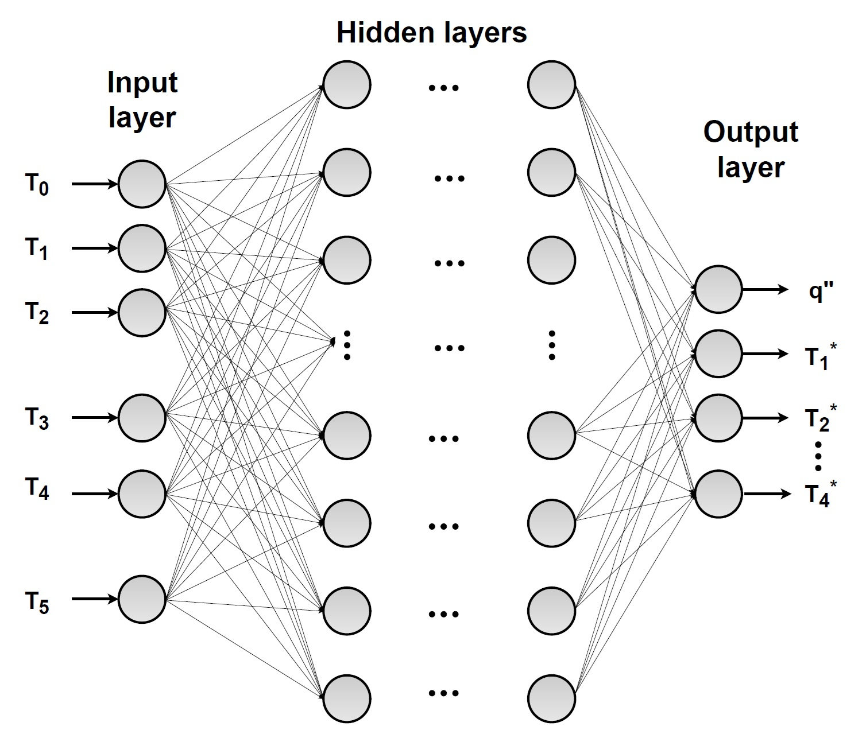
Sample Deep Neural Network

Slide 7

Let’s Break It Down
Feature: An input variable to ML model.
Label/Target: The output the model predicts.
Training Set: Data used to teach the model.
Testing Set: Data used to evaluate performance.
Epoch: One complete training cycle.
Loss Function: Measure of how wrong predictions are.
Optimizer: Algorithm that updates the model.
Activation Function: Introduces non-linearity to help model learn complex patterns.

Slide 8
Cheat Sheet
Syntax / Function | Meaning / Use
import numpy as np, import pandas as pd, import matplotlib.pyplot as plt | Load libraries for math, data handling, and plotting
uploaded = files.upload() | Upload a CSV file from local machine into Colab
pd.read_csv(io.BytesIO(uploaded['file.csv'])) | Read uploaded CSV file into a pandas DataFrame
data[['col1','col2']] | Select multiple columns from the dataset
data['col'] | Select a single column
data.sample(frac=0.8) | Randomly select 80% of rows for training
data.drop(train.index) | Remaining rows become test set
DataFrame.describe().transpose() | Gives mean, std, min, max for each feature
(x - mean) / std | Normalizes data (z-score scaling)
tf.keras.Sequential([...]) | Build a model by stacking layers sequentially
layers.Dense(units, activation) | Fully connected (dense) layer; units = neurons
model.compile(optimizer, loss, metrics) | Configure model’s learning process
model.fit(X, y, epochs, validation_split) | Train the model on training data
model.predict(X_test) | Generate predictions for new input data
plt.plot(hist['epoch'], hist['mae']) | Plot Mean Absolute Error vs. epochs
plt.scatter(test_labels, predictions) | Compare actual vs. predicted values
plt.hist(errors) | Show distribution of prediction errors

Slide 9
Importing Libraries
import tensorflow as tf
from tensorflow import keras
from tensorflow.keras import layers
import numpy as np
import pandas as pd
import matplotlib.pyplot as plt
What they do:
TensorFlow/Keras → framework for building & training neural networks
NumPy → numerical operations, arrays, math backbone
Pandas → table-like data handling (like Excel in Python)
Matplotlib → plotting results and visualizations
Analogy: Like bringing measuring instruments + graph paper before starting a lab experiment.

Slide 10
Loading Your Data
from google.colab import files
uploaded = files.upload() # Upload 'thermal_data_100.csv'
import io
data = pd.read_csv(io.BytesIO(uploaded['thermal_data_100.csv’]))
What it does:
Prompts you to upload a CSV file from your computer
Reads the uploaded file into a pandas DataFrame
Why needed:
Makes your experimental results accessible for machine learning.
Analogy:
Like opening your lab notebook so you can work with the recorded data.

Slide 11
Selecting Features (X) and Labels (y)
input_cols = ["T0", "T1", "T2", "T3", "T4", "T5"]
output_cols = ["q", "T1*", "T2*", "T3*", "T4*"]
X = data[input_cols] # Features (inputs)
y = data[output_cols] # Labels (outputs)
What it does:
X → input data (temperature readings at different points)
y → target values the model must predict (heat transfer rate q and predicted temperatures T1*–T4*).
Why needed:
The ML model learns patterns from X → y.
Analogy:
Recipe ingredients (X) vs. the final dish outcome (y).

Slide 12
Splitting into Train/Test Sets
train_dataset = data.sample(frac=0.8, random_state=42) # 80% training
test_dataset = data.drop(train_dataset.index) # 20% testing
train_labels = train_dataset[output_cols]
test_labels = test_dataset[output_cols]
What it does:
Randomly assigns 80% of the data for training.Keeps the remaining 20% for testing.Separates input features (input_cols) and target outputs (output_cols).
Why needed:
Ensures the model is trained on one portion of the data but tested on unseen data for fair evaluation.
Analogy:
Practice problems (training) vs. the final exam (testing).

Slide 13
Normalizing Your Data
train_stats = train_dataset[input_cols].describe().transpose()
def norm(x):
return (x - train_stats['mean']) / train_stats['std']
normed_train_data = norm(train_dataset[input_cols])
normed_test_data = norm(test_dataset[input_cols])
What it does:
Calculates mean & standard deviation of training data.
Rescales features so they have mean = 0 and std = 1.
Why needed:
Ensures all features are on the same scale, helping the neural network learn efficiently.
Analogy: Like converting all your lab measurements to standard units before comparing (e.g., cm → m).

Slide 14
Building the Neural Network
baseline_model = keras.Sequential([
layers.Input(shape=(len(input_cols),)), # input layer
layers.Dense(64, activation='relu'),
layers.Dense(64, activation='relu'),
layers.Dense(64, activation='relu'),
layers.Dense(num_outputs) # 5 outputs: q, T1*, T2*, T3*, T4*
])
Layers:
Input layer: matches number of input features (T0–T5).Hidden layers: 3 layers with 64 neurons each, relu activation → extracts patterns.Output layer: 5 neurons → predicts 5 target values (q, T1*, T2*, T3*, T4*).
Why needed:
Transforms raw inputs step by step into meaningful predictions.
Analogy:
Like passing lab measurements through multiple analysis steps, then finally reporting all key results at once.

Slide 15
Compiling the Model
optimizer = tf.keras.optimizers.Adam(learning_rate=0.001)
baseline_model.compile(
optimizer=optimizer,
loss='mse', # Mean Squared Error
metrics=['mae', 'mse'] # Track Mean Absolute Error & MSE
)
What it does:
Optimizer: Adam → updates weights efficiently during training.
Loss: Mean Squared Error (MSE) → measures difference between predicted & actual values.
Metrics: MAE & MSE → monitor training progress.
Why needed: Tells the model how to learn and how to measure errors.
Analogy: Like picking your calibration method and defining how accurate your measurements should be in the lab.

Slide 16
Training
history = baseline_model.fit(
normed_train_data.values, # normalized input features
train_labels.values, # target outputs
epochs=1000,
validation_split=0.2, # 20% of training data for validation
verbose=0,
callbacks=[tensorboard_callback, PrintDot()] # optional progress visualization
)
What it does:
Runs the training loop 1000 times (epochs).
Uses 80% of data to train and 20% to validate at each epoch.
Updates model weights to minimize MSE.
Analogy: Like performing repeated lab experiments to gradually refine your setup and improve results.

Slide 17
Prediction
baseline_test_predictions = baseline_model.predict(normed_test_data.values)
What it does:
Uses the trained neural network to predict all 5 outputs (q, T1*, T2*, T3*, T4*) for the test set.
Why needed:
Evaluate how well the model can predict new/unseen data.
Analogy:
Like using a calibrated sensor to measure new lab samples without performing the full experiment.

Slide 18
Summary
# 1️⃣ Libraries
import tensorflow as tf, numpy as np, pandas as pd
import matplotlib.pyplot as plt
# 2️⃣ Load data
from google.colab import files
data = pd.read_csv(io.BytesIO(files.upload()['thermal_data_100.csv']))
# 3️⃣ Features & Labels
X = data[["T0","T1","T2","T3","T4","T5"]]
y = data[["q","T1*","T2*","T3*","T4*"]]
# 4️⃣ Train/Test Split
train = data.sample(frac=0.8, random_state=42)
test = data.drop(train.index)
y_train, y_test = train[y.columns], test[y.columns]
# 5️⃣ Normalize
stats = train[X.columns].describe().transpose()
norm = lambda x: (x - stats['mean'])/stats['std']
X_train, X_test = norm(train[X.columns]), norm(test[X.columns])

Slide 19
Summary
# 6️⃣ Build Model
model = tf.keras.Sequential([
tf.keras.layers.Input(shape=(6,)),
tf.keras.layers.Dense(64, activation='relu'),
tf.keras.layers.Dense(64, activation='relu'),
tf.keras.layers.Dense(64, activation='relu'),
tf.keras.layers.Dense(5)
])
model.compile(optimizer=tf.keras.optimizers.Adam(0.001),
loss='mse', metrics=['mae','mse'])
# 7️⃣ Train & Predict
history = model.fit(X_train.values, y_train.values,
epochs=1000, validation_split=0.2, verbose=0)
y_pred = model.predict(X_test.values)

